Slide 1
Business On the Frontlines SOP
CRS
April, 2014

Slide 2






Notes:
Point 1: Humble beginnings
Point 2: Evolving partnerships
Point 3: Our reach today

Slide 3
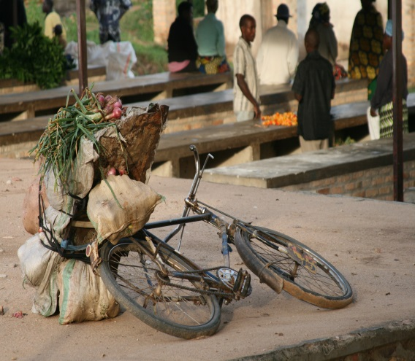

BOTFL Core Capabilities
Investigative Research
Interviewing
Financial Analysis
Business Model Development
Outside Eyes
Project Examples:
Youth Unemployment
Micro finance
Co-operative Management
Health Care
Energy
Agribusiness
Mining
Nutrition
Cross sector Engagement

Slide 4
Successful Strategy #1: Use Different Techniques to Cook with Great Ingredients

Slide 5
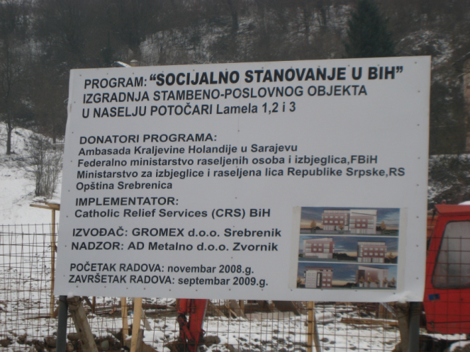
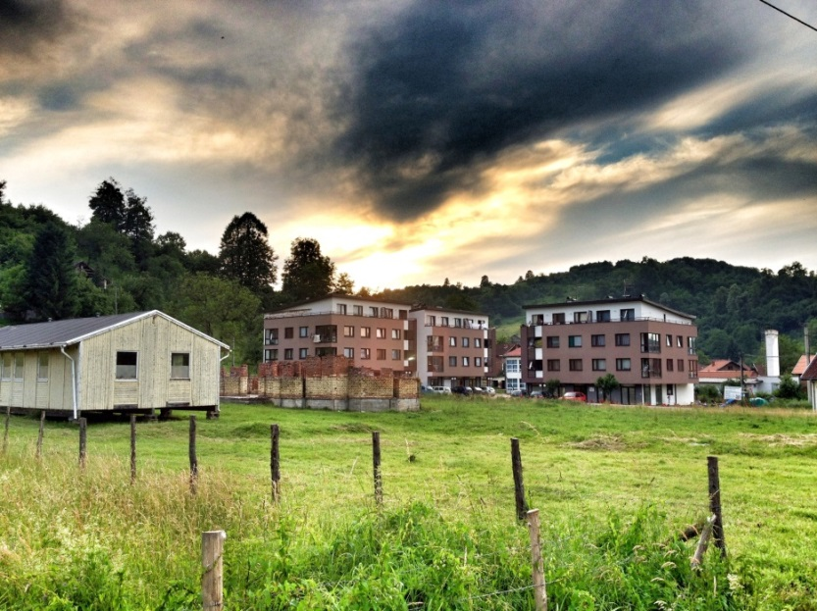
Example: Bosnia 2009
CRS refugee resettlement project to provide housing for widows, orphans and demobilized soldiers.
Worked with BOTFL to recognize opportunity to use existing infrastructure to create business incubator on housing site.

Slide 6
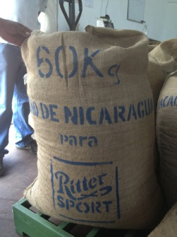
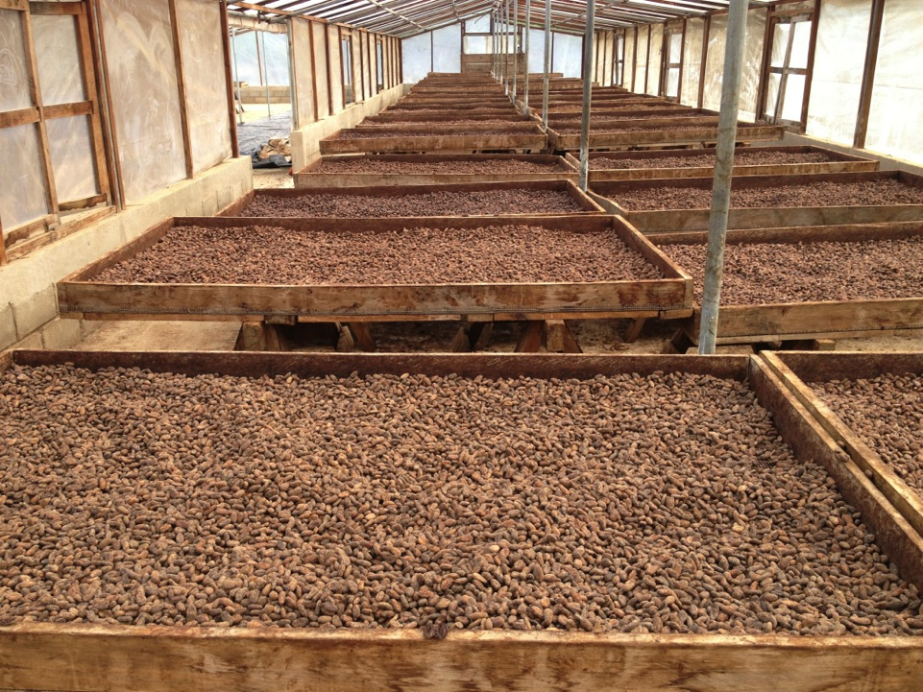
Example: Nicaragua 2013
COOPSEIUNA’s sales agreement with Ritter Sport makes it one of the highest potential sites for future investment. However, cacao cultivation and processing should be having a greater positive impact on farmer livelihoods than is being observed.
BOTFL team analyzed the Cacao value chain and compared it with the cooperative’s financial statements finding an 80K deficit:
40k in purchasing in excess of inputs processed
40K in sales unaccounted for
Resulted in closing of first phase of project, formal audit and continued mediation with former co-op management to recover farmer funds.
CRS no longer works with this co-op.

Slide 7
Successful Strategy #2: Find a Hidden Problem

Slide 8
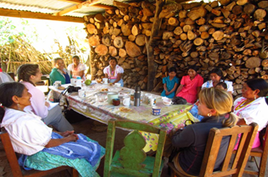
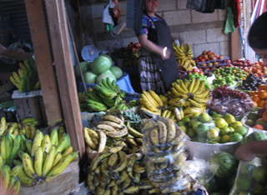
Example: Guatemala 2012
Original Project:
Assess opportunities in banana cultivation with the goal of improving farmer income and food security.
Cooperativa Todos Hermanos
Real Story:
Cooperative was on the verge of financial ruin. Bananas were unsustainable long term project and not the silver bullet needed. Worked with co-operative to leverage existing processing plant and better understand own financials to avoid co-op dissolution.

Slide 9
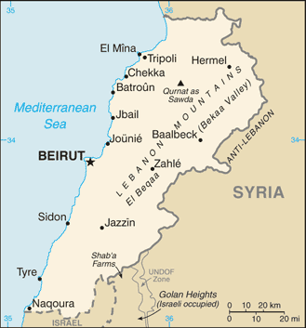

Example: Lebanon 2009
Conflict 2006
Rolling black-outs and brown-outs a way of life in post-conflict Lebanon.
Massive private investment in electrical capacity.
Perceived as “peace dividend” as improves quality of life for all Lebanese.
Investment in Private Electricity Capacity, 2008
Interviews with senior Lebanese businessmen reveal that investment consciously built significant redundant capacity and the net effect is to implicitly lower the “cost” to most Lebanese of the next conflict

Slide 10
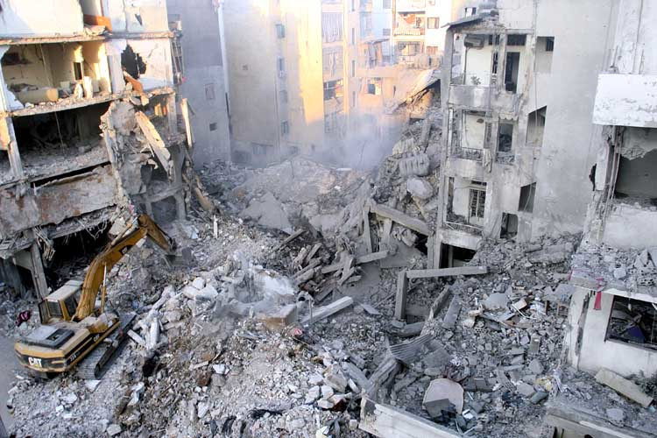
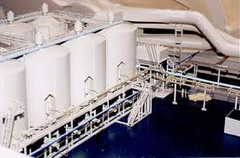
Example: Bosnia 2009
Sarajevo, 1994
1995 multi-billion Euro, European Union and World Bank investment to commercialize Bosnia’s aluminum deposits.
By 1998, 3000 recently demobilized militia troops employed; employees paid fair wages, including disabled ones.
Aluminum exports to European Union countries earn hard currency
European Union/World Bank Investment, 1995
Interviews with Managing Director and senior executives reveal that aluminum smelter hires only Croat Catholics.
Aluminum Smelter
Notes:
Emily, in this case, you should make it sound really good – even the employment of former combatants, many of which are handicapped – but then only at the end say that they only employ Croat Catholics

Slide 11
Successful Strategy #3: Work Outside CRS Boundaries

Slide 12



















Example: Mindanao 2012
Land Footprint
Mining
$870 Billion untapped resources
Environmental and displacement risk for CRS beneficiaries
Bishop and Church anti-mining stance focused on large scale operations
Large Scale (ex: Tampakan)
Medium Scale (mechanized SSM)
Artisanal (SSM)
*Bubble size denotes employment*
Findings
Risk largely from artisanal mining
No comparable alternative livelihoods
Diversity of perspectives on mining even within stakeholder across economic social and environmental concerns creates opportunities for advocacy
Environmental Impact
Occupation | Wages
Professionals | 697
Service Workers | 267
Farmers/Fish/Forestry | 194
Laborers (Unskilled) | 178
Artisanal Mining Labor | 1,400
ANTI MINING
PRO MINING

Slide 13
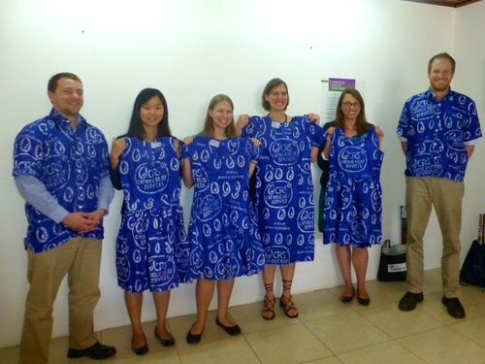
Example: Ghana 2014
CRS utilizes funding more efficiently than companies.
Newmont Microfinance Example: Beneficiaries Impacted Per $1000
BOTFL team met corporations such as Newmont Mining and identified opportunities for mutually beneficial collaboration.
Opportunities include both corporate social responsibility and operations/value chain
Notes:
Emily, in this case, you should make it sound really good – even the employment of former combatants, many of which are handicapped – but then only at the end say that they only employ Croat Catholics

Slide 14
Successful Strategy #4: Leading Edge Innovation

Slide 15
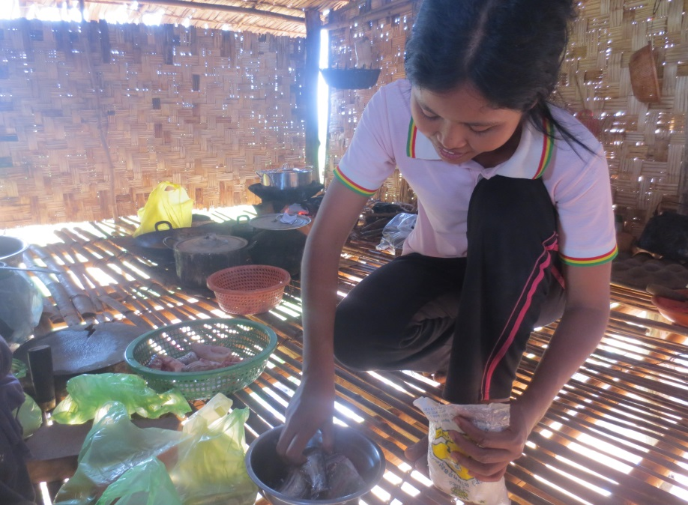

Example: Cambodia 2014
Innovative photo narrative project funded by CRS HQ sought to understand the underlying cause of intractably high levels of childhood stunting.
BOTFL team used principles of designed thinking and qualitative research to use the photo narrative data to drive CRS Cambodia nutrition and Health System Strengthening strategy.
Notes:
Emily, in this case, you should make it sound really good – even the employment of former combatants, many of which are handicapped – but then only at the end say that they only employ Croat Catholics

Slide 16
Factors that Enable Successful CRS – BOTFL Teams

Slide 17
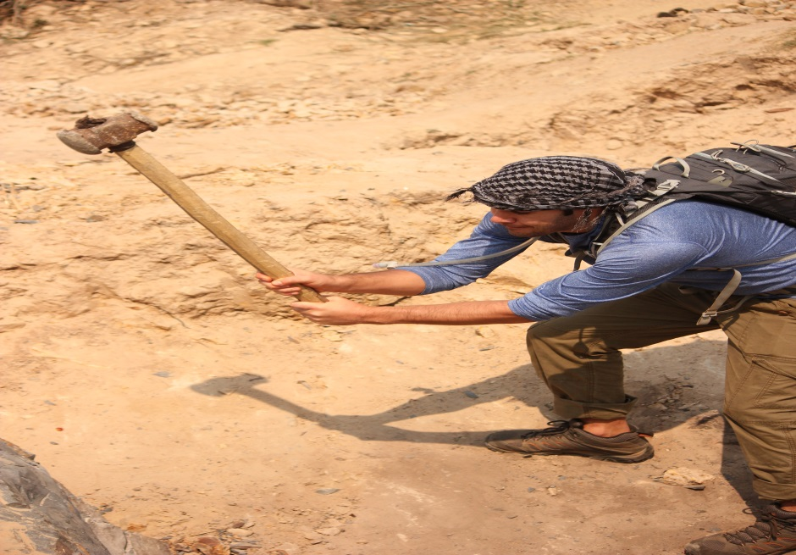

Factor 1: Deep Dive
Bishop Quote
Chance to really meet people, work with them, live with them, understand their lives.
Cook and eat with families
Work on farms
Break rocks
Notes:
Emily, in this case, you should make it sound really good – even the employment of former combatants, many of which are handicapped – but then only at the end say that they only employ Croat Catholics

Slide 18
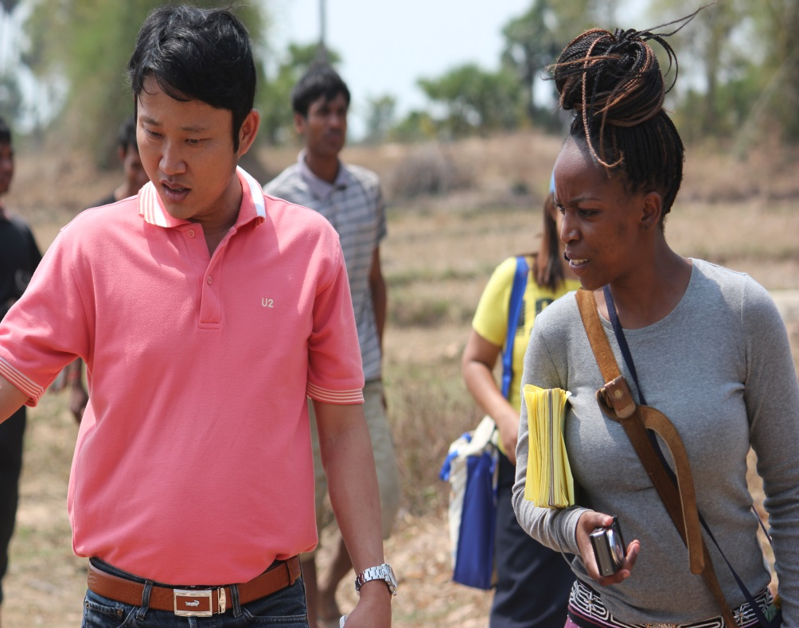
Factor 2: Planning
Year long commitment from a country program:
Thoughtful scope of work
Weekly calls with students
In-country partnership
Co-production of final deliverables
First call with RD in June to select country program.
First call with CR and PM in July to develop project descriptions.
Scope of work formalized by September.
The only spring semester course that starts in June and ends in August.
Notes:
Emily, in this case, you should make it sound really good – even the employment of former combatants, many of which are handicapped – but then only at the end say that they only employ Croat Catholics

Slide 19
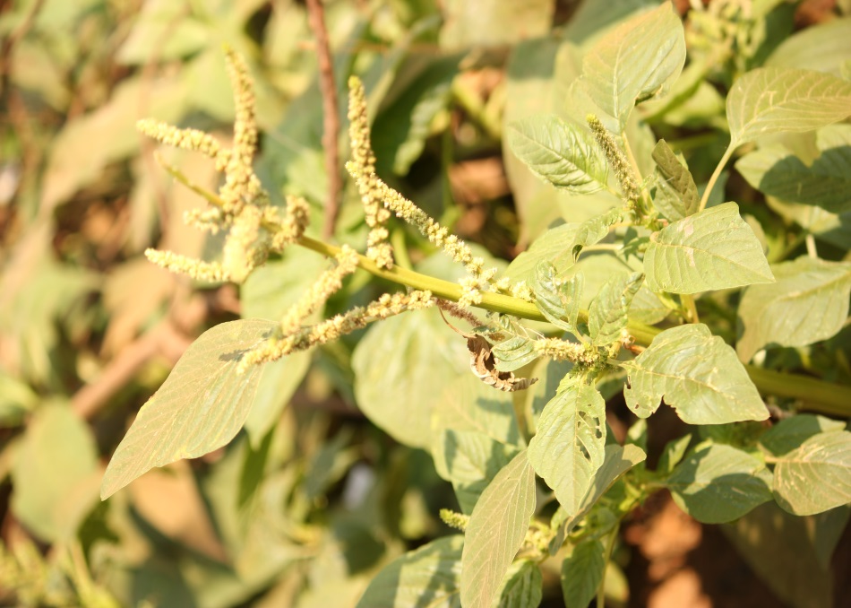
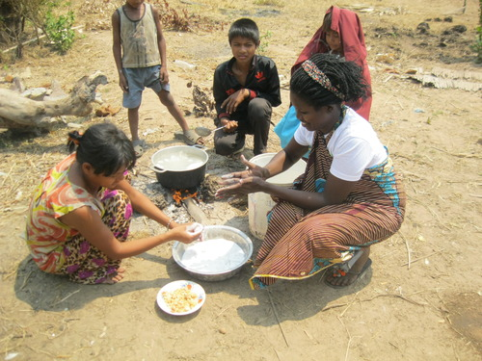
Factor 3: Timing and Funding
Projects that have existing funding streams are difficult to modify and therefore do not benefit as much from BOTFL involvement.
Projects that have established timelines or are already structured are difficult to modify and therefore do not benefit as much from BOTFL involvement.
Notes:
Emily, in this case, you should make it sound really good – even the employment of former combatants, many of which are handicapped – but then only at the end say that they only employ Croat Catholics

Slide 20
How Can BOTFL Support Agency Strategy
Design Questions:
Country lead vs. HQ direction
Local needs vs. Agency Strategic Priorities
Process/Timing to design BOTFLVII
Notes:
Emily, in this case, you should make it sound really good – even the employment of former combatants, many of which are handicapped – but then only at the end say that they only employ Croat Catholics

